Slide 1
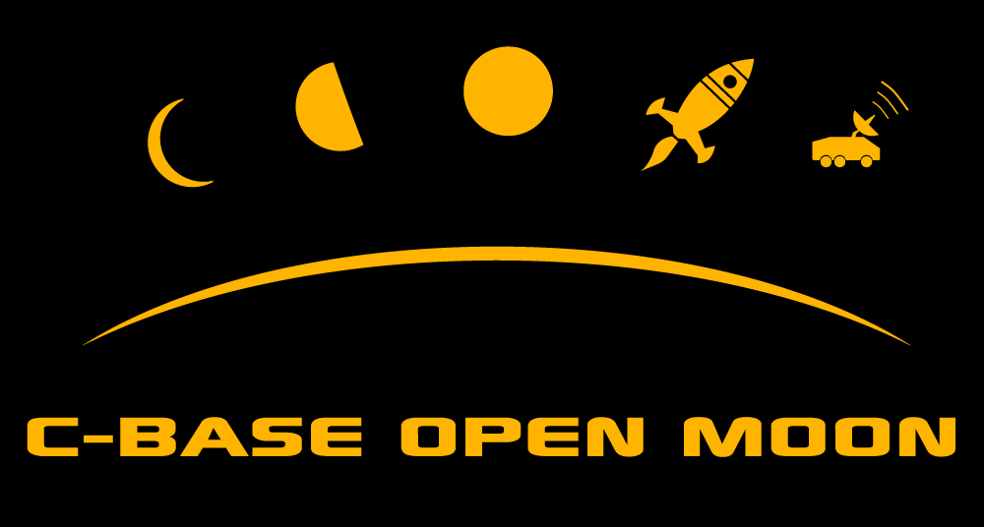
A brief history

Slide 2
Challenge for grammar school kids 14-15y
Competition:
Take over control of the enemy bot
You know the system, when you know the leaks
Deadline: May 2011 / School Centennial

Slide 3
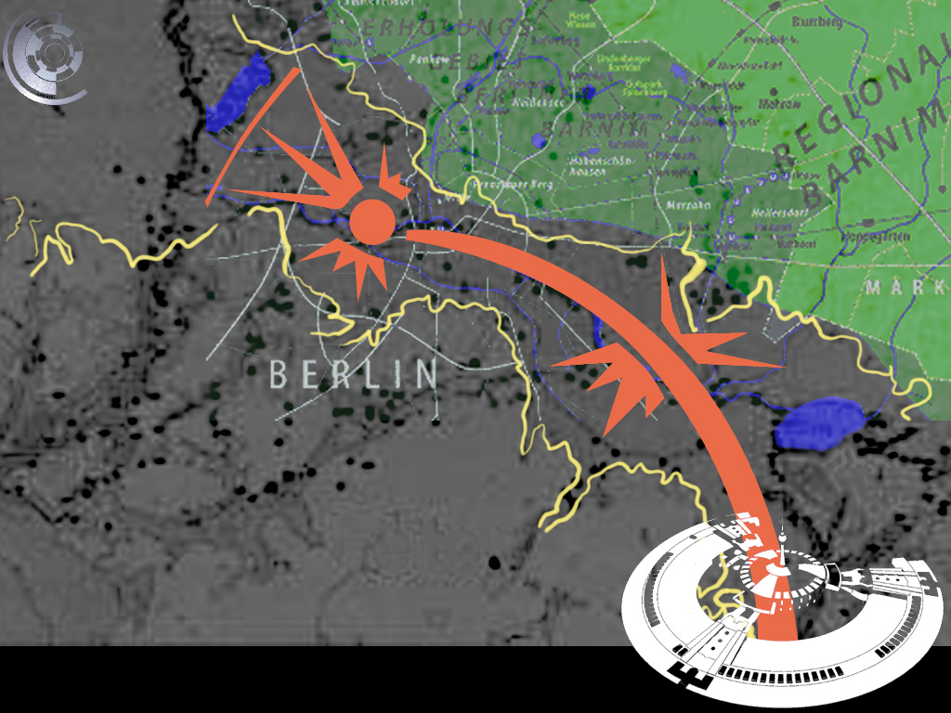

Slide 4
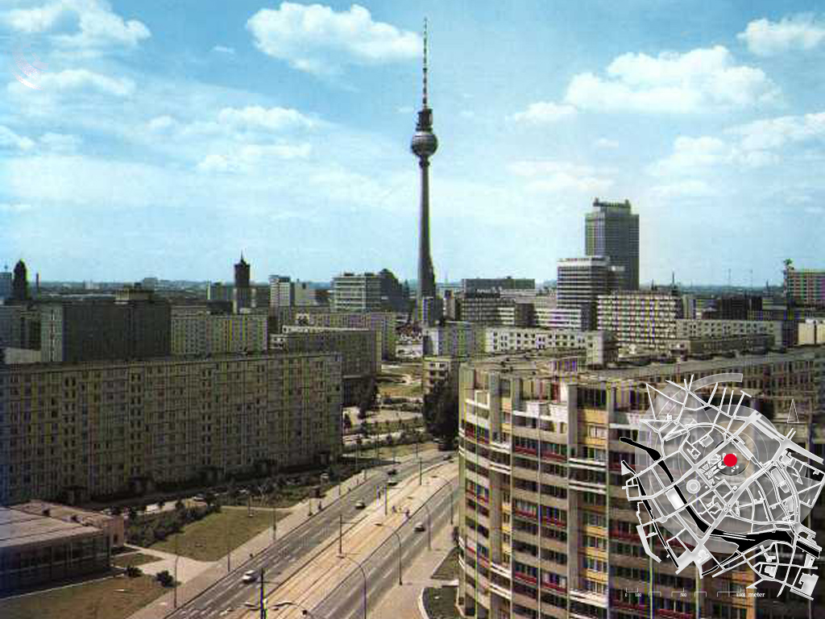
60% of Berlin would vanish, if c-base starts right now…

Slide 5
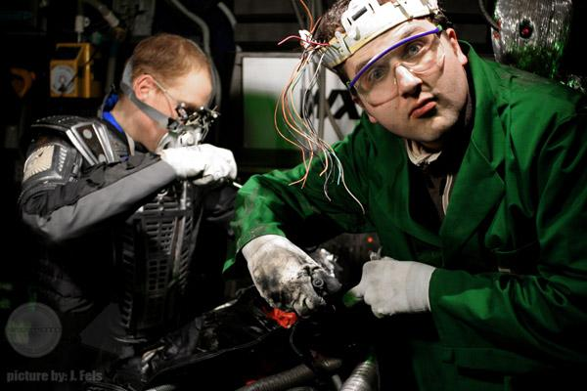
reconstructioneering the future

Slide 6
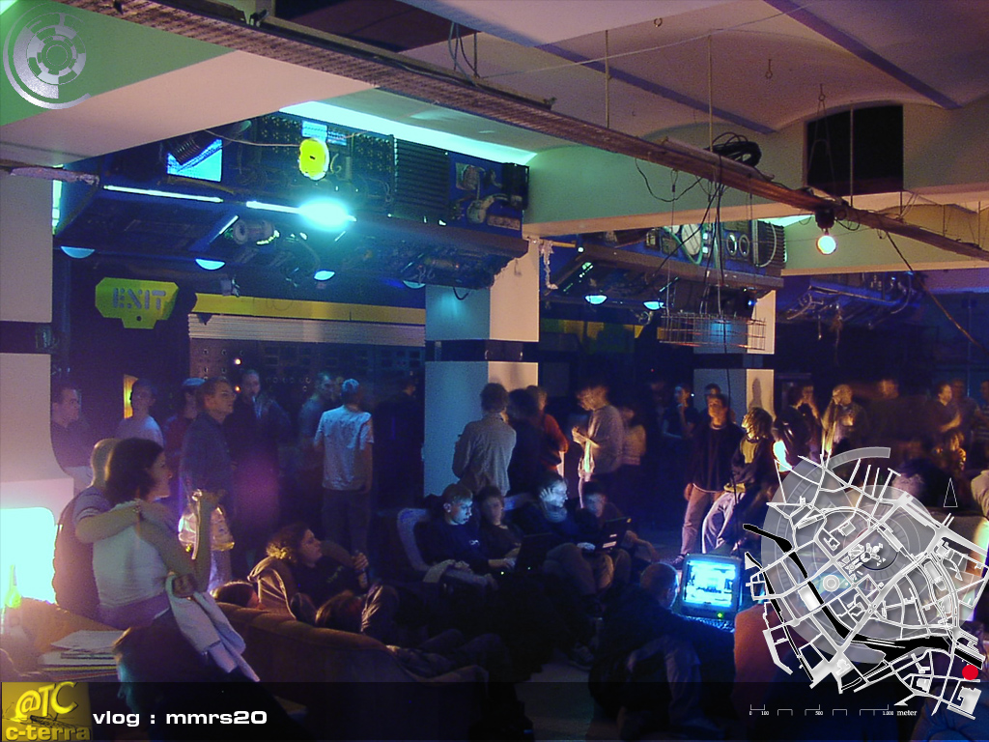
c-base - mother of all hackerspaces
be future compatible

Slide 7
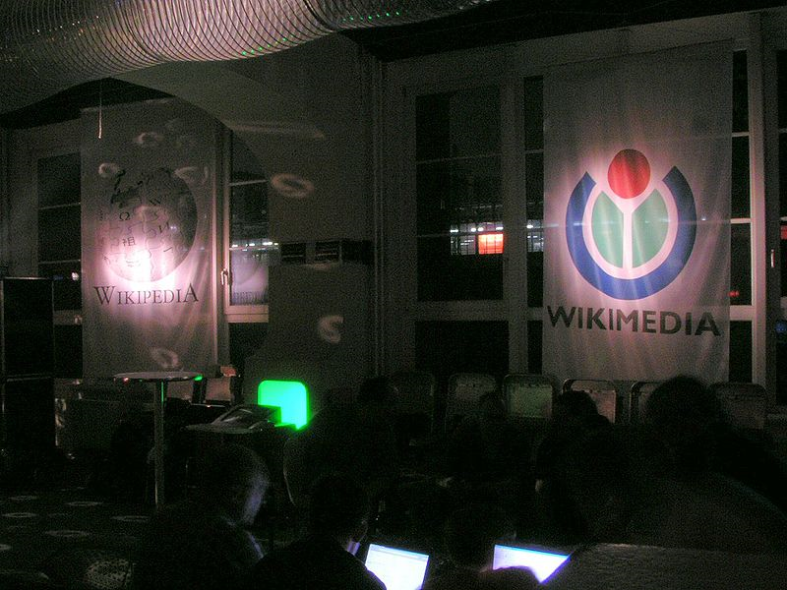
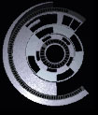
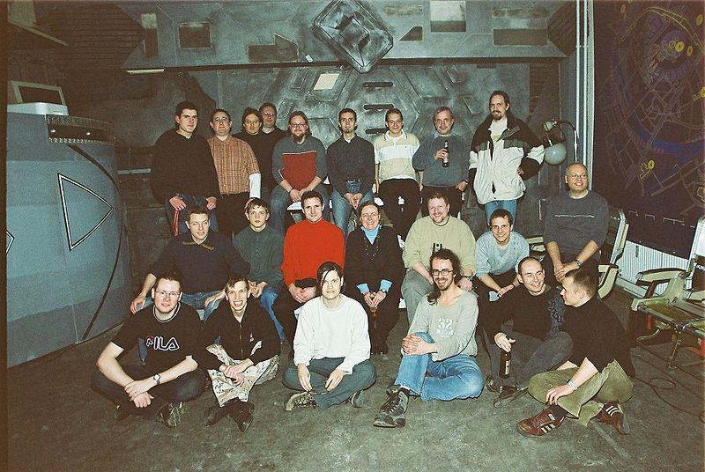
c-base hosts
community events
-wikipedia
-OpenSource
-Free WLAN

Slide 8
Community into Space
Turn Community into Commoonity

Slide 9
Organisation Structure
Rover
Business
Communication
GLXP / Commoonity
Design
Education
MINT / STEM
Rocket Engineering
Proof of Concept

Slide 10
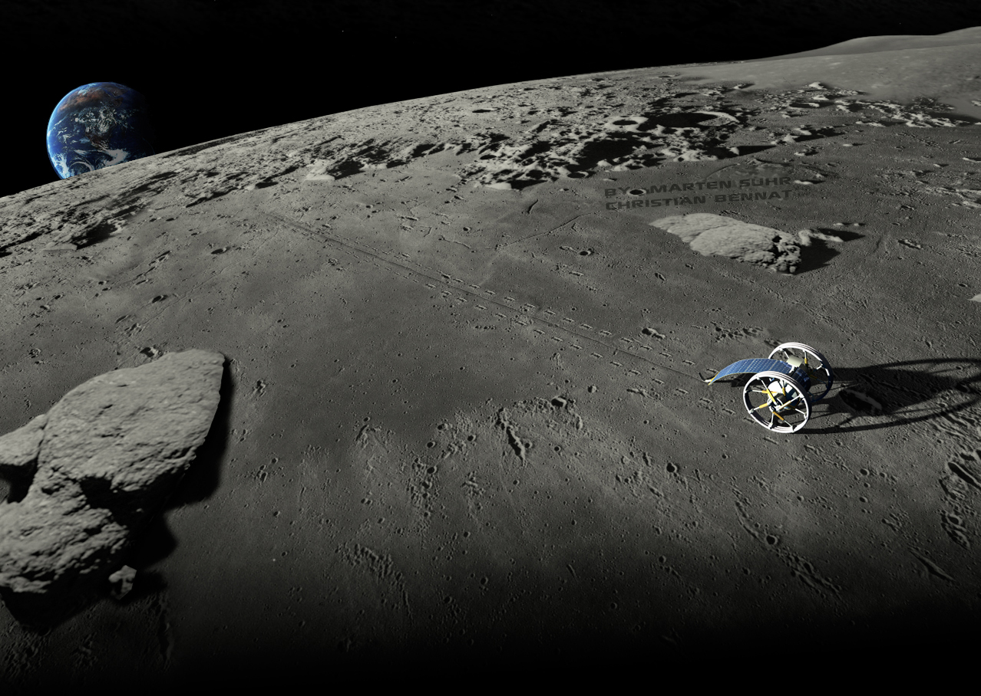
c-rove: expendable spokes

Slide 11
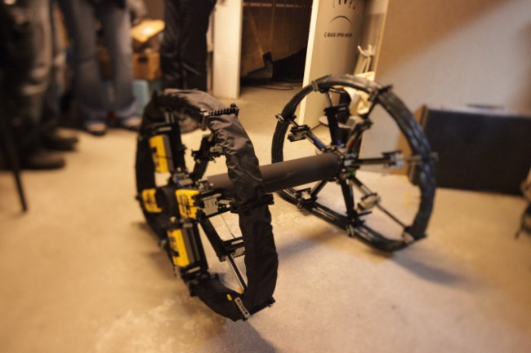
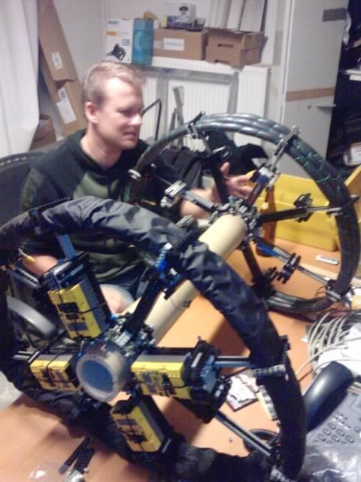
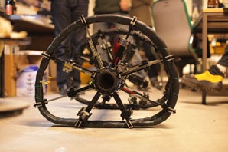
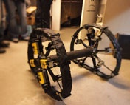
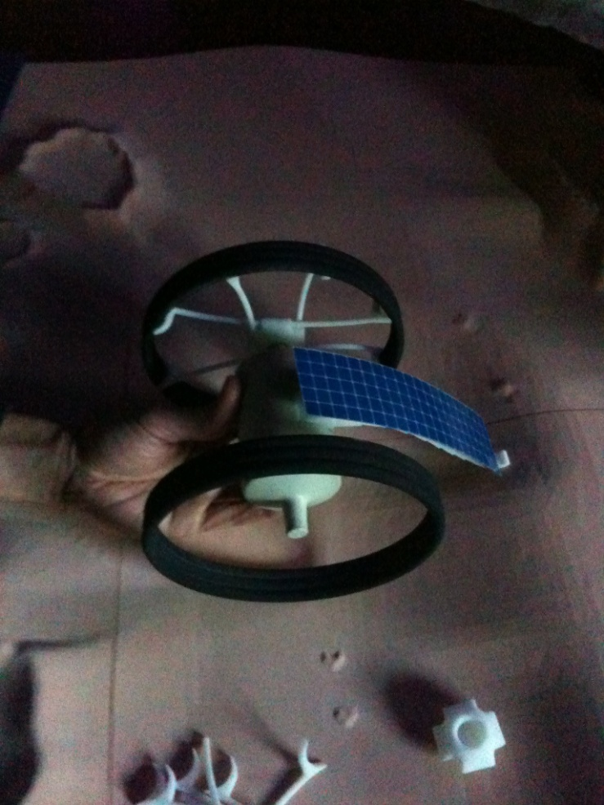
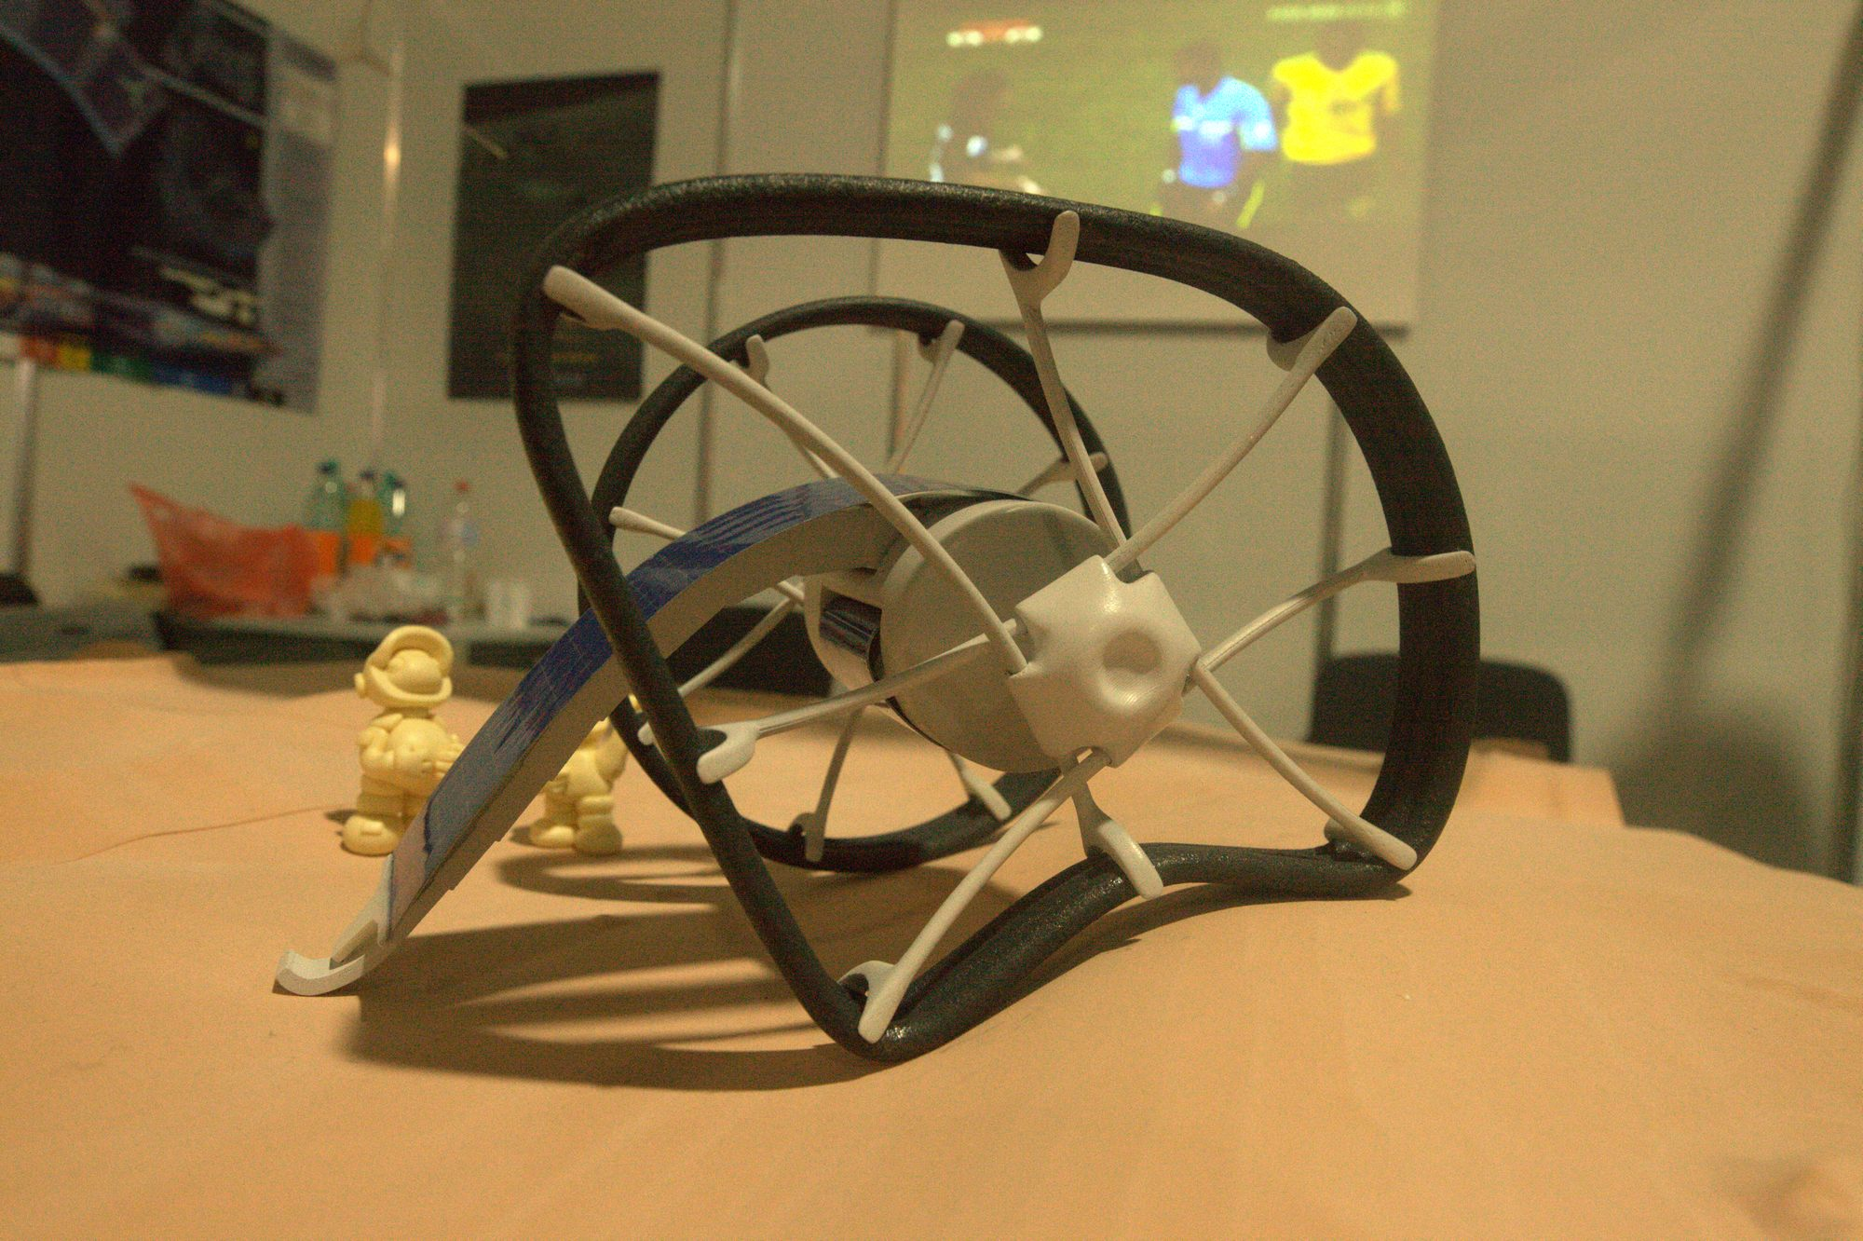
Proof of concept
Prototyping

Slide 12
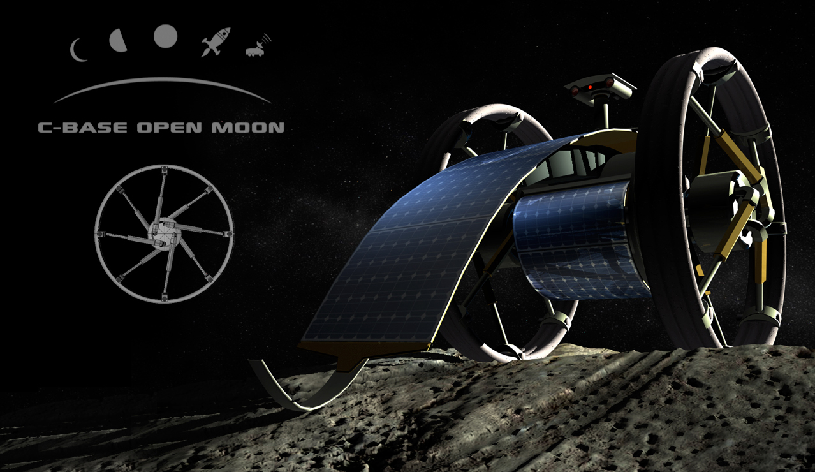
c-rove – a terrestrial wheel chair concept

Slide 13
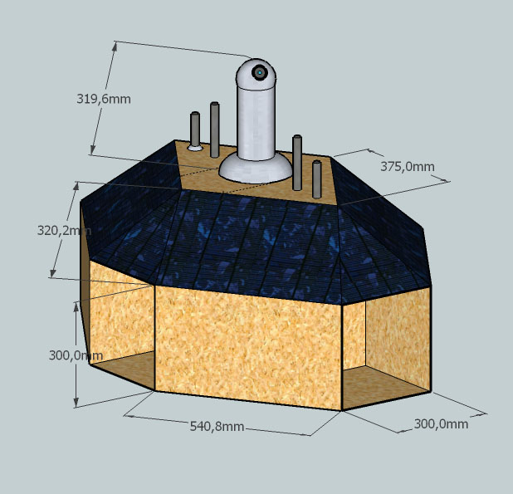
RoSt - RobotStation
Simulation of remote missions on unknown planets
RoSt serves 4 docking ports for rovers´ power supply

Slide 14
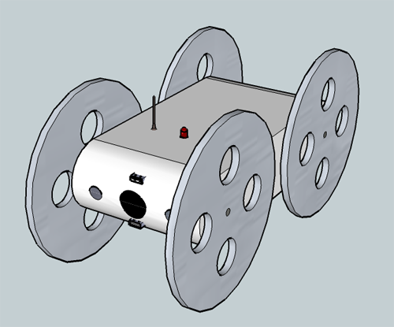
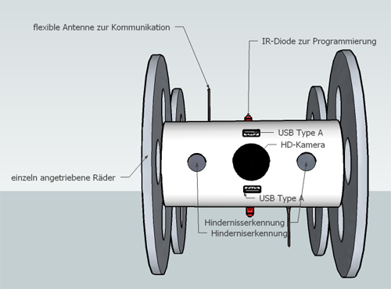
The RoSt-Bots
No solar panels – power supply via RoSt
to be build by 14-15yr old schoolkids

Slide 15
Mission to grammar school kids:
Construct your own bot
Connect it to the RoSt
Control it from your PC
Take over remote control of other bots
„Turn curiosity into exaltation and curisosity turns itself into knowledge“

Slide 16
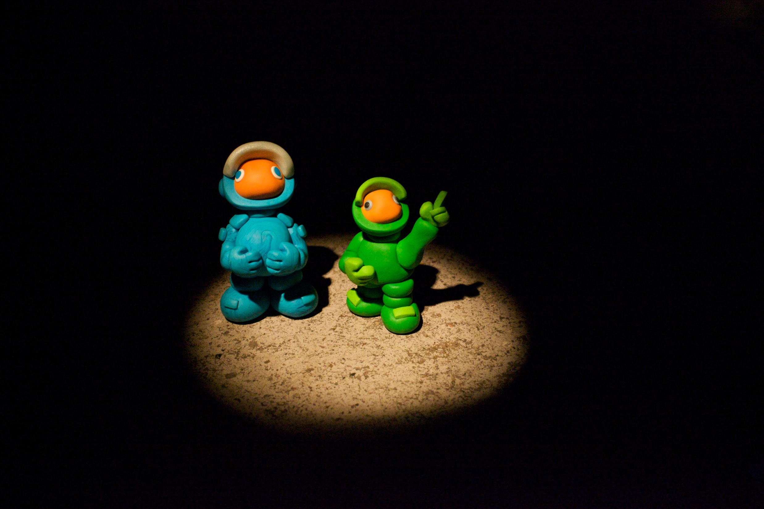
Ranger & Lunik
support out of a direction
never expected to come
Notes:
launching own businesses

Slide 17
Notes:
far beyond shaping the edge of space they are launching their personal rocket

